Slide 1
Past Simple

Slide 4
Past Simple
vs
Past Continuous

Slide 8
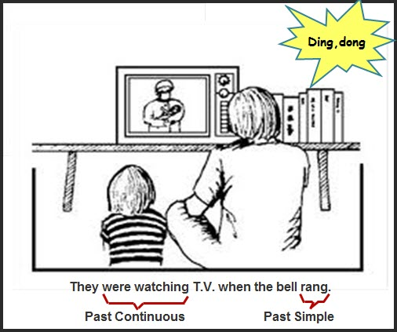

Slide 9
Past Simple
vs
Past Perfect

Slide 11
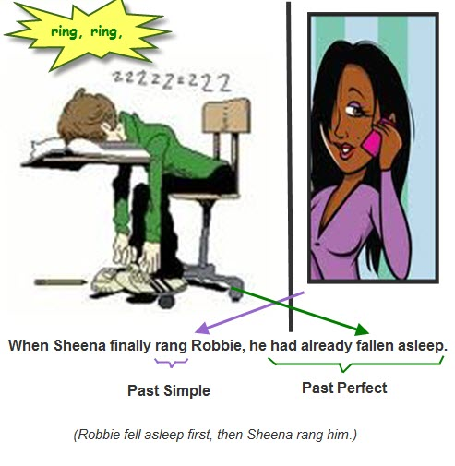

Slide 12
